Slide 1
Data Analysis and Interpretation

Slide 2
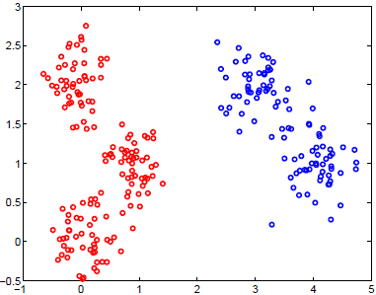
Recap from Week 4
Cluster: A collection/group of data objects/points
similar (or related) to one another within the same group
dissimilar (or unrelated) to the objects in other groups

Slide 3
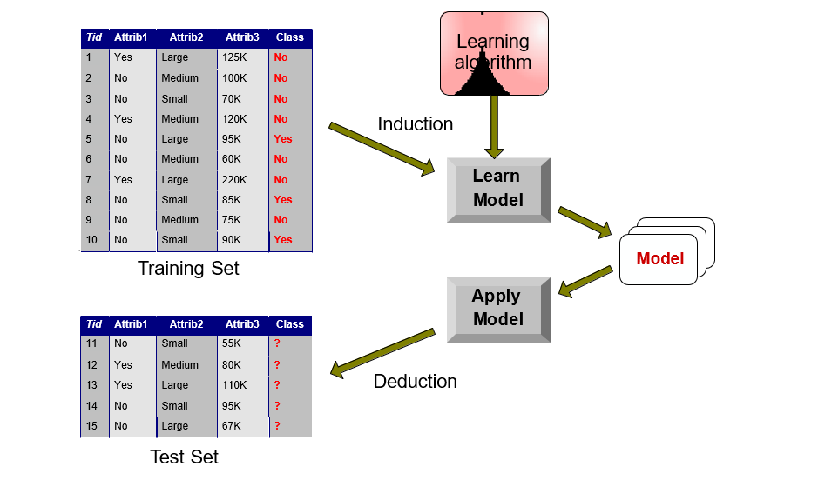
Recap from Week 5
Classification Pipeline
Training errors: number of classification errors on training records.
Generalization (test) errors: number of classification errors on test records.
Model underfitting: model is too simple such that both Training error and Generalization error are high.
Model overfitting: A model that fits the training data too well (with too low training errors) may have a higher generalization error than a model with higher training error.
A good model should have low errors of both types.

Slide 4
Recap from Week 5
Classification vs. Regression:
Classification
Student Profile
Predicting Student
Pass or Fail
Regression
Student Profile
Predicting Student Mark

Slide 5
3803ICT course structure
Analysis of special types of data
W7. Time Series
W8. Textual Data
W9. Graph Data
Analysis with big data infrastructure
W10. Distributed Data Analysis
W11. Cloud-based Data Analysis
W12. Revision
W1. Introduction to Data Analytics
Data Preparation and Preprocessing
W2. Data Preparation and Preprocessing
Data Analysis and Interpretation
W3. Exploratory Data Analytics
W4. Statistical Data Analytics
W5. Predictive Data Analytics
Visualization
W6. Data Visualization

Slide 6
Predictive Analysis
Forecasting: Temporal Prediction
Recommender Systems: Personalized Prediction

Slide 7
I. Forecasting
What is forecasting?
Forecasting is a tool used for predicting future based on past information.
Applications:
Strategic planning (long range planning)
Finance and accounting (budgets and cost controls)
Marketing (future sales, new products)
Production and operations

Slide 8
Forecasting: Example
Demand for Mercedes E Class
We try to predict the future by looking back at the past
Predicted demand looking back six months
Time
Jan
Feb
Mar
Apr
May
Jun
Jul
Aug
Actual demand (past sales)
Predicted demand

Slide 9
Forecasting: Another Example
Month | E-class Sales | M-class Sales
Jan | 23,345 | ?
Feb | 22,034 | ?
Mar | 21,453 | ?
Apr | 24,897 | ?
May | 23,561 | ?
Jun | 22,684 | ?
Jul | 23,764 | ?
Question: Can we predict the new model M-class sales based on the data in the the table?

Slide 10
Forecasting: Another Example
Month | E-class Sales | M-class Sales
Jan | 23,345 | ?
Feb | 22,034 | ?
Mar | 21,453 | ?
Apr | 24,897 | ?
May | 23,561 | ?
Jun | 22,684 | ?
Jul | 23,764 | ?
Question: Can we predict the new model M-class sales based on the data in the the table?
Answer: Maybe... We need to consider how much the two markets have in common

Slide 11
Forecasting Fundamentals
Basic Principles
Forecasting Process
Models
Accuracy

Slide 12
1. Basic Principles
Assumptions:
Historical data contains some patterns → support predicting the future
Best practices:
Forecasts are rarely perfect
Forecasts are more accurate for shorter than longer time periods
Forecasts are more accurate for grouped data than for individual items
Every forecast should include an error estimate
Notes:
A forecast is only as good as the information included in the forecast (past data)
Forecasting is based on the assumption that the past predicts the future
When forecasting, think carefully whether or not the past is strongly related to what you expect to see in the future

Slide 13
2. Forecasting Process
Step 1. Decide what needs to be forecast:
What is the purpose of the forecast?
How important is the past in estimating the future?
The answers will help determine techniques
Step 2. Evaluate and analyze appropriate data
Step 3. Select and test the forecasting model
Step 4. Apply the forecast on real data
Step 5. Monitor forecast accuracy over time
Notes:
The first two steps are similar to the ones of Data Science process. In this lecture, we focus on the remaining steps.

Slide 14
3. Forecasting Models
Time-series model: models that predict future demand based on past history trends
Causal model: models that use statistical techniques to establish relationships between various items and demand
Simulation: models that can incorporate some randomness and non-linear effects

Slide 15
Forecasting: Time-Series Model
Forecast based only on past values, no additional information
Approach: look for data patterns, i.e. data = historical pattern + random variation:
Trends: persistent, overall upward and downward pattern
typically over several years
e.g. population, technology, age, culture
Seasonality: regular pattern of up and down fluctuations
typically over 1 year
e.g. weather, customs
Random variation: erratic, unsystematic, “residual” fluctuations
unforeseen events (stocks)
Short duration and norepeating
Notes:
Time-series model assumes that factors influencing past and present will continue influence in future

Slide 16
Historical patterns: Example
Trend component
Seasonal peaks
Actual demand line
Demand for product or service
Average demand over 4 years
Random variation
| | | |
1 2 3 4
Time (years)

Slide 17
Forecasting: Time-Series Model
Techniques:
Moving Average
Weighted Moving Average
Exponential Smoothing
Exponential Smoothing with Trend
Seasonality
Notes:
Time-series model assumes that factors influencing past and present will continue influence in future

Slide 18
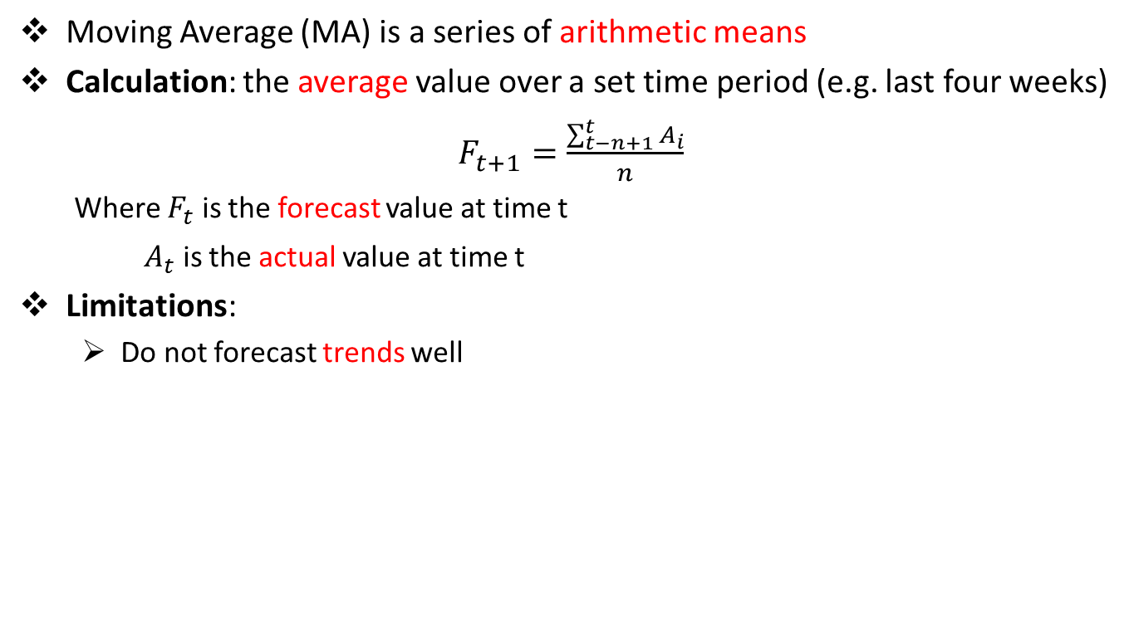
Time-Series: Moving Average Method
Moving Average (MA) is a series of arithmetic means
Calculation: the average value over a set time period (e.g. last four weeks)
$F_{t+1}=\frac{\sum_{t−n+1}^{t}{A_{i}}}{n}$
Where $F_{t}$ is the forecast value at time t
$A_{t}$ is the actual value at time t
Limitations:
Do not forecast trends well

Slide 19
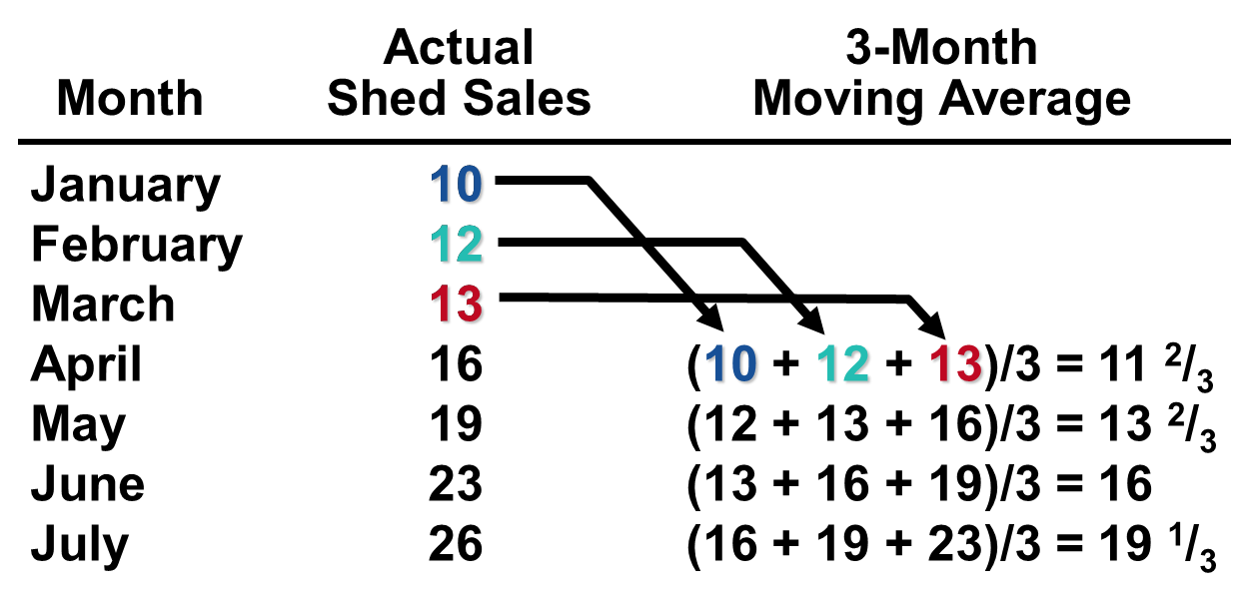
Time-Series: Moving Average Method
Example

Slide 20
Time-Series: Moving Average Method
Graph of Moving Average
Moving Average Forecast
30 –
28 –
26 –
24 –
22 –
20 –
18 –
16 –
14 –
12 –
10 –
Actual Sales
Shed Sales
| | | | | | | | | | | |
1 2 3 4 5 6 7 8 9 10 11 12
MV is lagged behind actual data

Slide 21
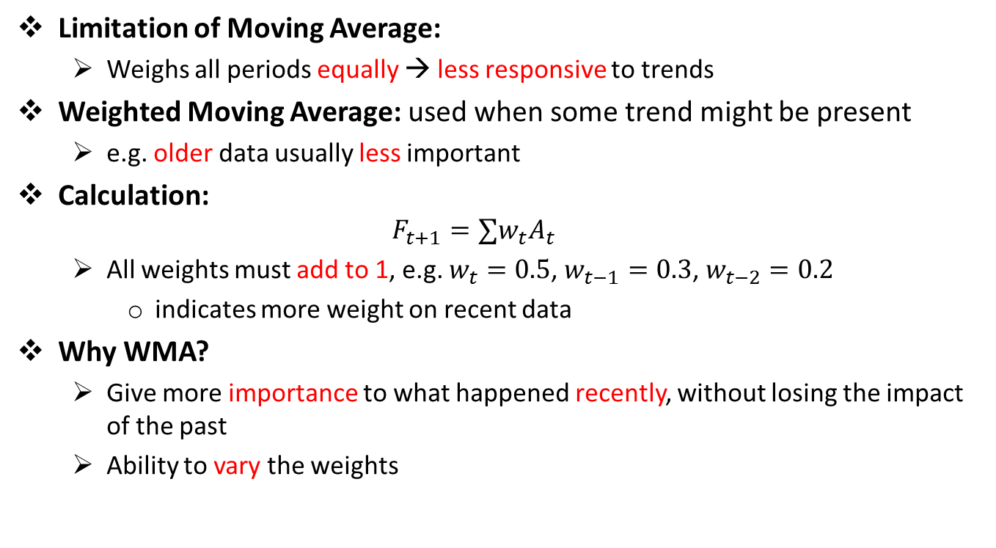
Weighted Moving Average
Limitation of Moving Average:
Weighs all periods equally → less responsive to trends
Weighted Moving Average: used when some trend might be present
e.g. older data usually less important
Calculation:
$$F_{t+1}=∑w_{t}A_{t}$$
All weights must add to 1, e.g. $w_{t}=0.5$, $w_{t−1}=0.3$, $w_{t−2}=0.2$
indicates more weight on recent data
Why WMA?
Give more importance to what happened recently, without losing the impact of the past
Ability to vary the weights

Slide 22
Weighted Moving Average: Example
Demand for Mercedes E-class
Actual demand (past sales)
Prediction when using 6-month MA
Prediction when using 6-months WMA
For a 6-month MA, attributing equal weights to all past data we miss the downward trend
Time
Jan
Feb
Mar
Apr
May
Jun
Jul
Aug

Slide 23
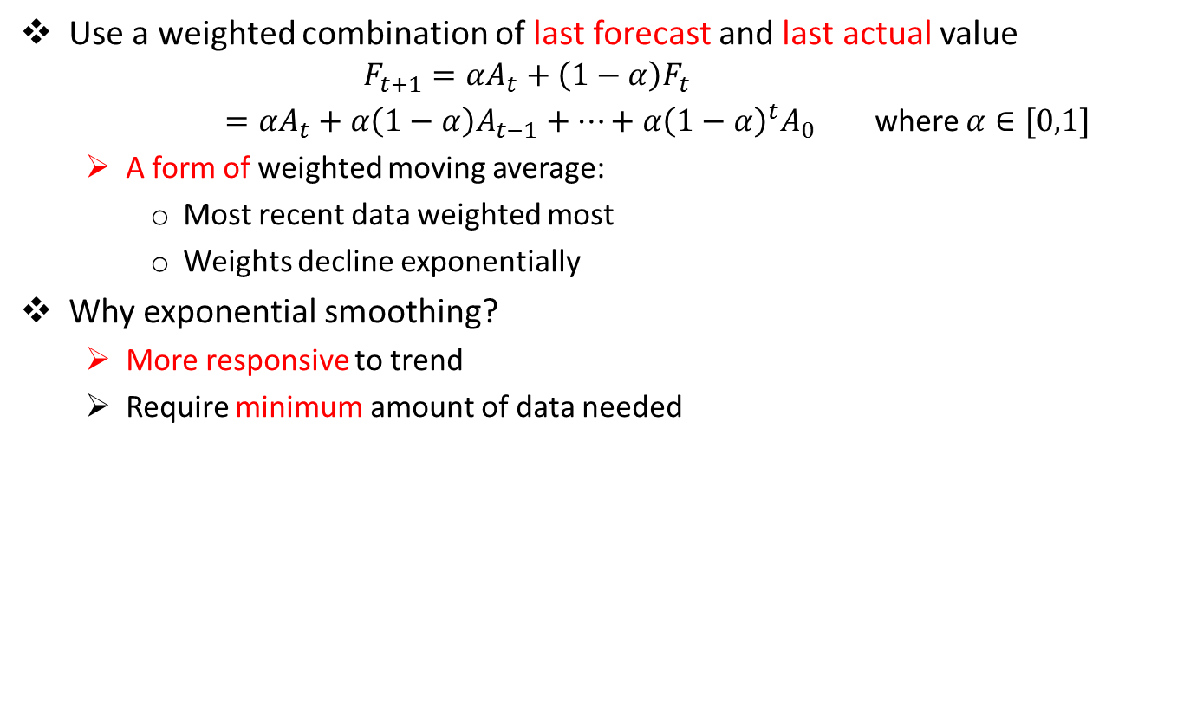
Time-Series: Exponential Smoothing
Use a weighted combination of last forecast and last actual value
$$F_{t+1}=αA_{t}+\left(1−α\right)F_{t}$$
$=αA_{t}+α\left(1−α\right)A_{t−1}+…+α{\left(1−α\right)}^{t}A_{0}$ where $α∈[0,1]$
A form of weighted moving average:
Most recent data weighted most
Weights decline exponentially
Why exponential smoothing?
More responsive to trend
Require minimum amount of data needed
Notes:
If no last forecast is available, average the last few periods or use naïve method
Choose high values of \alpha when underlying average is likely to change
Choose low values of \alpha when underlying average is stable

Slide 24
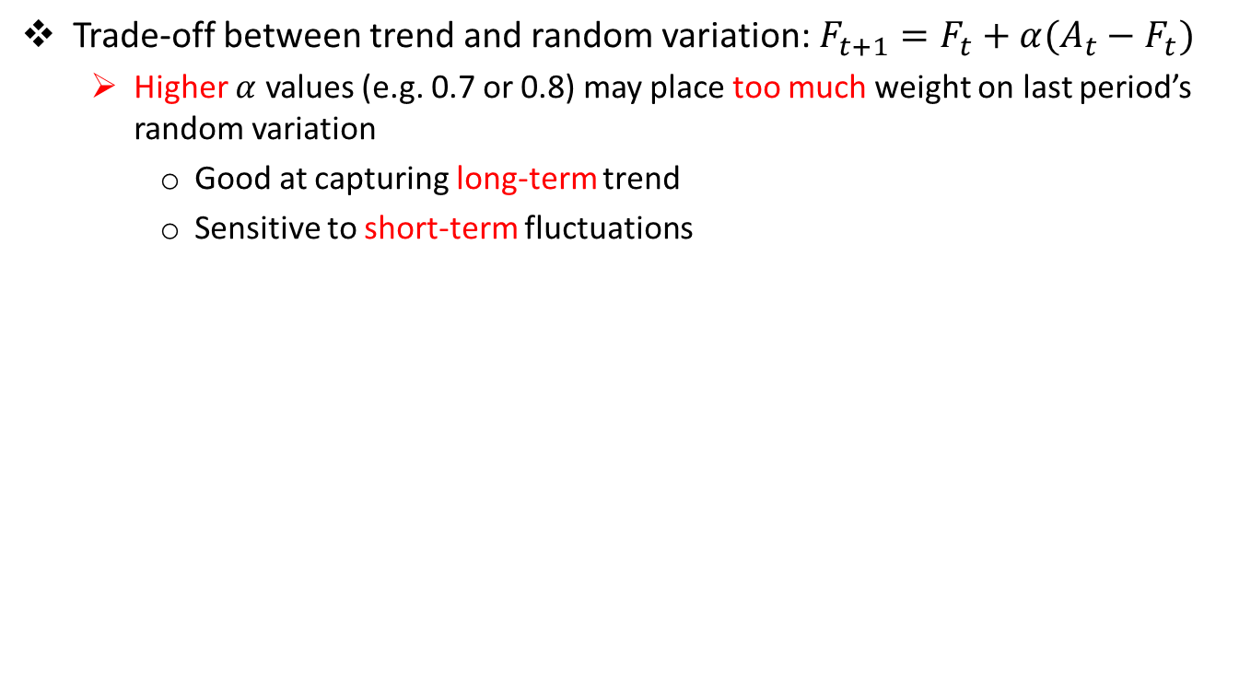
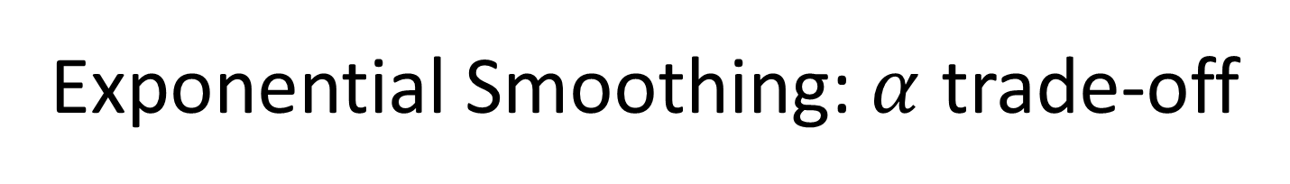
Exponential Smoothing: $α$ trade-off
Trade-off between trend and random variation: ${F_{t+1}=F}_{t}+α(A_{t}−F_{t})$
Higher $α$ values (e.g. 0.7 or 0.8) may place too much weight on last period’s random variation
Good at capturing long-term trend
Sensitive to short-term fluctuations
Notes:
Lower $α$ values mean there is little reaction to last period’s random variation

Slide 25
Time-series: Seasonality
A university must develop forecasts for the next year’s quarterly enrollments. It has collected quarterly enrollments for the past two years. What is the forecast for each quarter of next year?
Quarter | Year 1 | Year 2 | Year3
Fall | 24000 | 26000 | ?
Winter | 23000 | 22000 | ?
Spring | 19000 | 19000 | ?
Summer | 14000 | 17000 | ?

Slide 26
Time-series: Seasonality
Step 1. Calculate the average demand for each year
Step 2. Calculate seasonal indexes
Step 3. Average the indexes
Step 4. Forecast demand for the next year
Step 5. Multiple next year’s average seasonal demand by each average seasonal index
Quarter | Year 1 | Seasonal Index | Year 2 | Seasonal Index | Avg. Index | Year3
Fall | 24000 | 1.2 | 26000 | 1.24 | 1.22 | 26840
Winter | 23000 | 1.15 | 22000 | 1.05 | … | …
Spring | 19000 | 0.95 | 19000 | …
Summer | 14000 | 0.7 | 17000 | …
Average | 20000 |  | 21000 |  |  | 22000

Slide 27


Time-series: Seasonality
The multiplicative seasonal model can adjust trend data for seasonal variations in demand (jet skis, snow mobiles)
Steps:
Calculate the average demand per season
E.g.: average quarterly demand
Calculate a seasonal index for each season of each year:
Divide the actual demand of each season by the average demand per season for that year
Average the indexes by season
E.g.: take the average of all Spring indexes, then of all Summer indexes, ...
Forecast demand for the next year & divide by the number of seasons
Use regular forecasting method & divide by four for average quarterly demand
Multiply next year’s average seasonal demand by each average seasonal index
Result is a forecast of demand for each season of next year
Notes:
The same process can be formulated differently:
Find average historical demand for each season
Compute the average demand over all seasons
Compute a seasonal index for each season
Estimate next year’s total demand
Divide this estimate of total demand by the number of seasons, then multiply it by the seasonal index for that season

Slide 28
Forecasting: Causal Model
Causal models establish a cause-and-effect relationship between independent and dependent variables
A maker of golf shirts has been tracking the relationship between sales and advertising dollars. Use linear regression to find out what sales might be if the company invested $53,000 in advertising next year.
 | Sales $ (Y) | Adv.$ (X)
1 | 130 | 32
2 | 151 | 52
3 | 150 | 50
4 | 158 | 55
5 | ? | 53

Slide 29
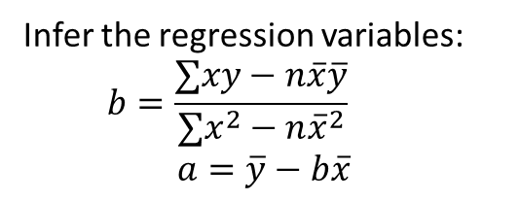
Causal Model: Problem
Fitting a trend line to historical data points to project into the future (medium to long-range)
Linear trends can be found using the least squares technique
Actual observation (y-value)
Infer the regression variables:
$$b=\frac{∑xy−n\overline{x}\overline{y}}{∑x^{2}−n{\overline{x}}^{2}}$$
$$a=\overline{y}−b\overline{x}$$
Dependent Variable
Trend line, y = a + bx
Predicting variable

Slide 30
Linear Regression: Example
A maker of golf shirts has been tracking the relationship between sales and advertising dollars. Use linear regression to find out what sales might be if the company invested $53,000 in advertising next year.
 | Sales $ (Y) | Adv.$ (X) | XY | X² | Y²
1 | 130 | 32 | 4160 | 2304 | 16,900
2 | 151 | 52 | 7852 | 2704 | 22,801
3 | 150 | 50 | 7500 | 2500 | 22,500
4 | 158 | 55 | 8690 | 3025 | 24964
5 | 153.85 | 53
Sum | 589 | 189 | 28202 | 9253 | 87165
Avg | 147.25 | 47.25

Slide 31
Forecasting: Evaluation
Mean Absolute Deviation (MAD)
Measures the total error in a forecast without regard to sign
Higher MAD implies worse performance
Mean Square Error (MSE)
Penalizes larger errors
Notes:
Need to know how much we should rely on our chosen forecasting method.
A more positive or negative MFE implies worse performance; the forecast is biased.
Errors can be:
Biased (consistent)
Random

Slide 32
Evaluation: Guideline on how to select the right forecasting model
The amount & type of available data
Some methods require more data than others
Degree of accuracy required
Increasing accuracy means more data
Length of forecast horizon
Different models for 3 month vs. 10 years
Presence of data patterns
Notes:
Lagging will occur when a forecasting model meant for a level pattern is applied with a trend

Slide 33


II. Recommendation Systems
Which mobile phone should I buy?
Where should I visit for my business trip?
Whom should I follow on Twitter?
Where should I invest my money?
Which tour is the best for our class?
Notes:
Individual recommendation
Group recommendation
If interested, see two recent conference tutorials
SIGKDD2014, Recommendation in Social Media
RecSys2014, Personalized Location Recommendation

Slide 34

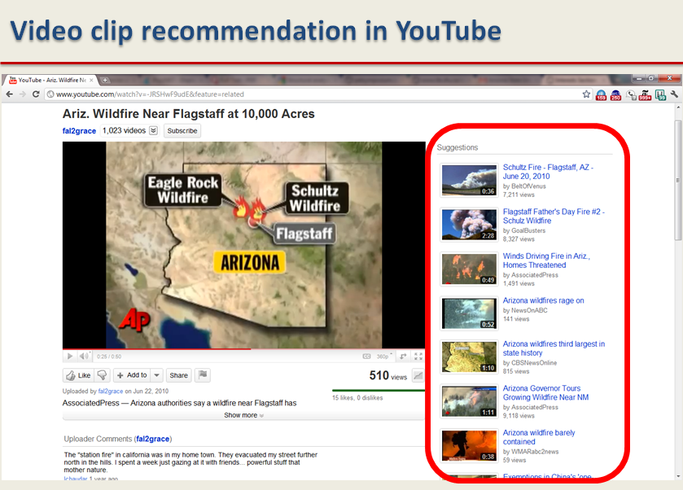
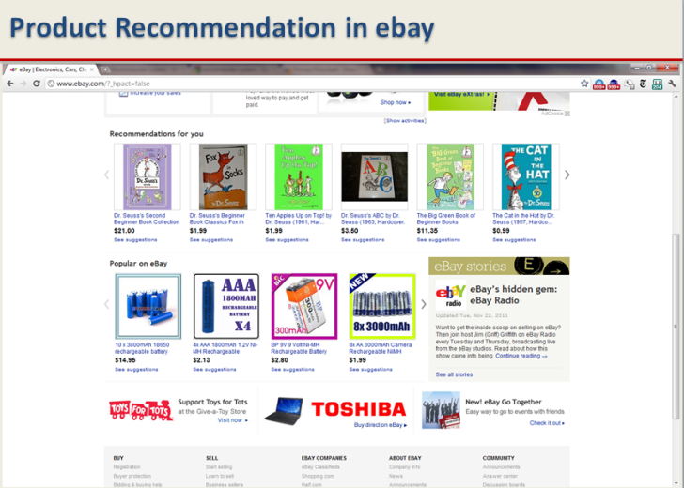
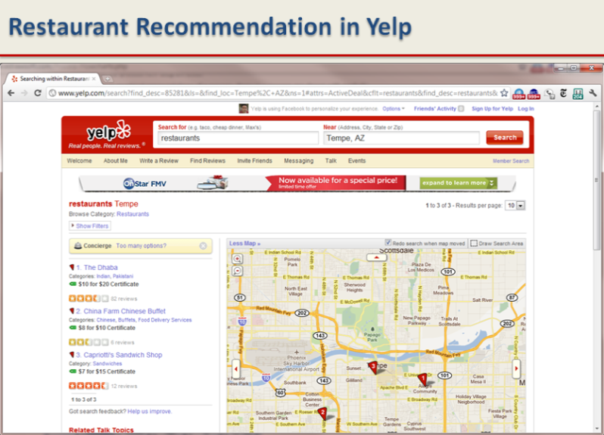
Recommender Systems - Applications
recommendation = personalized prediction

Slide 35
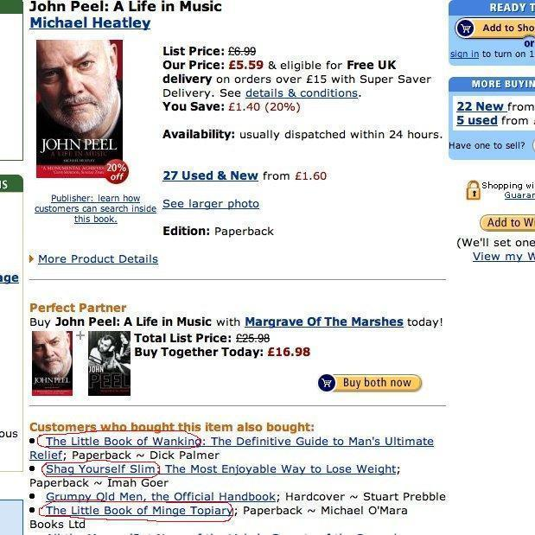
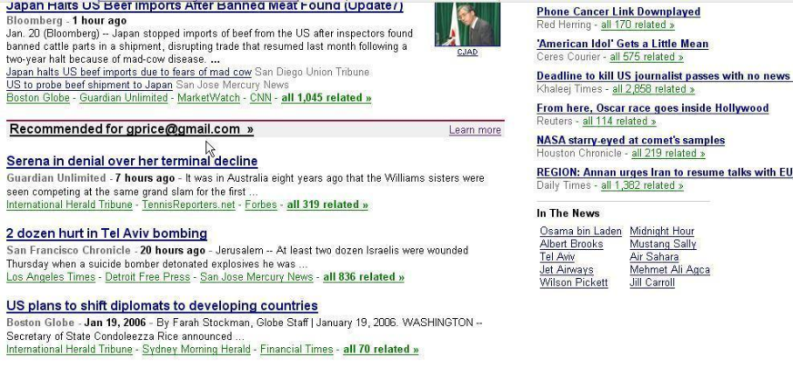
The value of recommendations
Netflix: 2/3 of the movies watched are recommended
Google News: recommendations generate 38% more click through
Amazon: 35% sales from recommendations
Choicestream: 28% of the people would buy more music if they found what they liked.

Slide 36
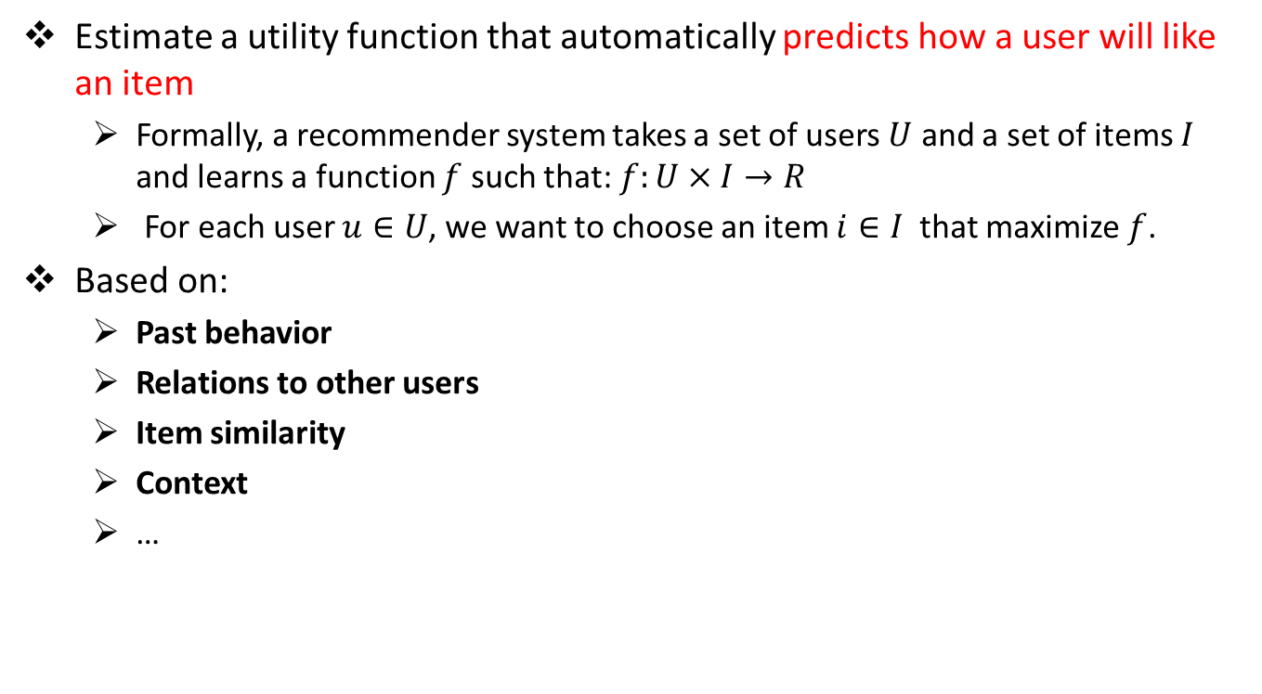
Recommender Systems - Problem
Estimate a utility function that automatically predicts how a user will like an item
Formally, a recommender system takes a set of users $U$ and a set of items $I$ and learns a function $f$ such that: $f:U×I→R$
For each user $u∈U$, we want to choose an item $i∈I$ that maximize $f$.
Based on:
Past behavior
Relations to other users
Item similarity
Context
…
Notes:
Recommender systems use historical data such as the user’s past preferences or similar users’ past preferences to predict future likes.
Assumption: Users’ preferences are likely to remain stable, and change smoothly over time. By watching the past users’ or groups’ preferences, we try to predict their future interests. Then we can recommend items of interest to them

Slide 37
Recommender Systems - Challenges
Cold-Start Problem
Recommender systems use historical data or information provided by the user to recommend items, products, etc.
When user join sites, they still haven’t bought any product, or they have no history.
It is hard to infer what they are going to like when they start on a site.
Data Sparsity
When historical or prior information is insufficient.
Unlike the cold start problem, this is in the system as a whole and is not specific to an individual.
Attacks:
Push Attack: pushing ratings up by making fake users
Nuke attack: DDoS attacks, stop the whole recommendation systems
Explanation
Recommender systems often recommend items with no explanation on why these items are recommended

Slide 38
Types of Recommender Systems
Content-based recommendation:
Recommend based on similarity between user features and item features
Rating-based recommendation (Collaborative Filtering)
Recommend based on rating matrix
Clustering-based recommendation
Recommend based on clusters of rating matrix
Notes:
items based only on the users past behavior
Cluster data before recommendation

Slide 39
1. Content-based recommendation
Assumption: a user’s interest should match the description of the items that the user should be recommended by the system.
The more similar the item’s description to that of the user’s interest, the more likely that the user finds the item’s recommendation interesting.
Goal: find the similarity between the user and all of the existing items is the core of this type of recommender systems

Slide 40
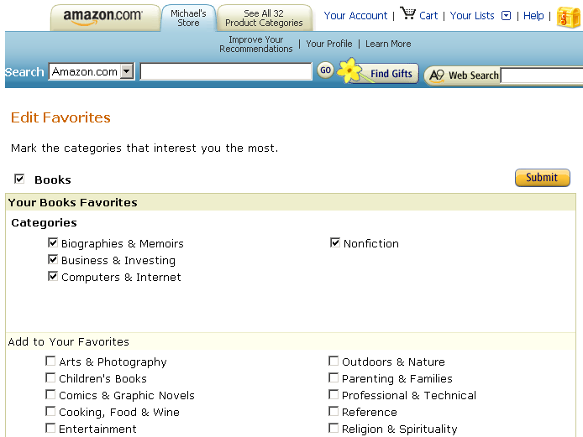
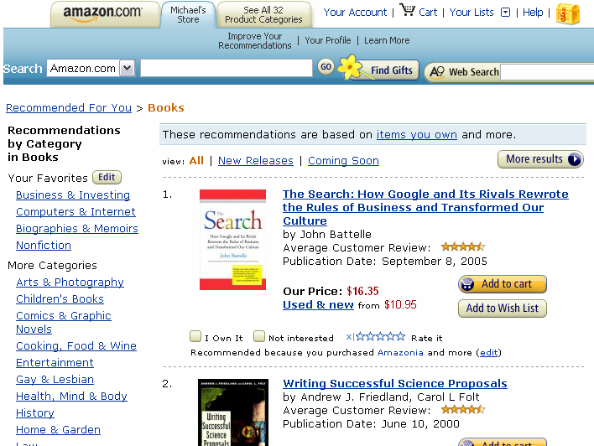
Content-based Recommendation: An Example
User profile
Items recommended

Slide 41
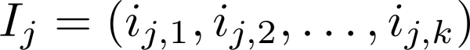
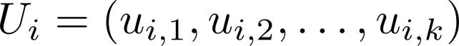
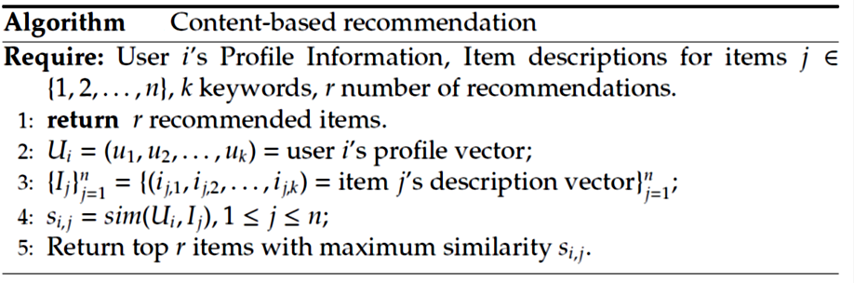
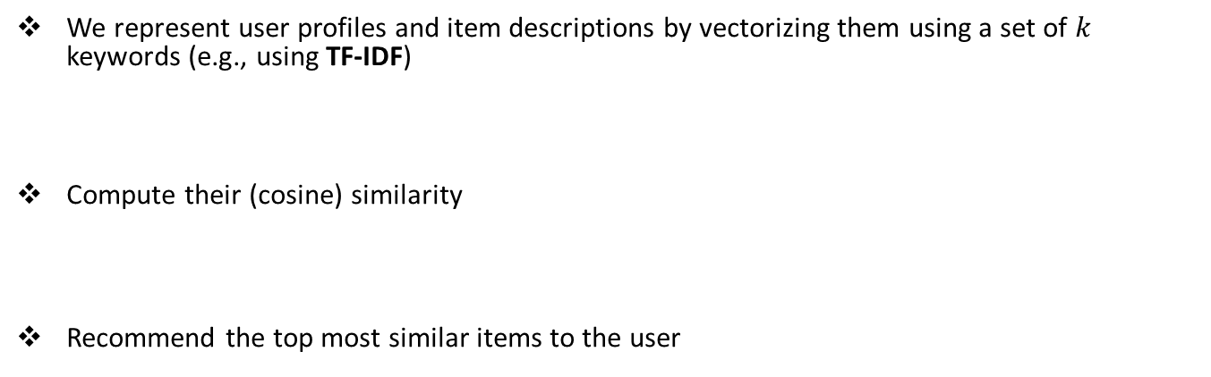
Content-based Recommendation: Algorithm
We represent user profiles and item descriptions by vectorizing them using a set of $k$ keywords (e.g., using TF-IDF)
Compute their (cosine) similarity
Recommend the top most similar items to the user

Slide 42
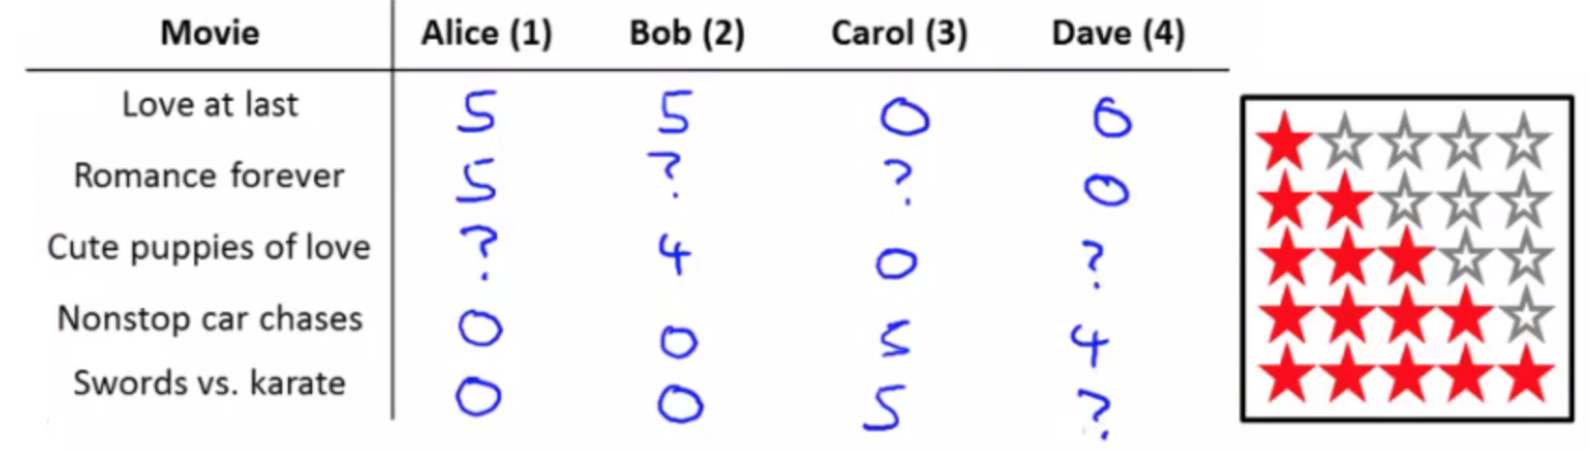
2. Rating-based Recommendation
AKA Collaborative filtering: recommend items by only users’ past behavior
Advantage: we don’t need to have additional information about the users or content of the items
Users’ rating or purchase history is the only information that is needed to work
Input: Rating matrix
Users rate (rank) items (purchased, watched)
Explicit ratings: entered by a user directly
Implicit ratings: inferred from other user behavior
e.g. the amount of time users spent on a webpage
e.g. the number of times users listen to a song
Notes:
If two users have similar rating vectors, we can use rating of one user to predict missing value of the other.
If two items have similar rating vectors, we can use rating of one item to predict missing value of the other.

Slide 43
User-based CF vs. Item-based CF
Find similar users to me and recommend what they liked
Why?: users with similar previous ratings for items are likely to rate future items similarly
Find similar items to those that I have previously liked
Why?: Items that have received similar ratings previously from users are likely to receive similar ratings from future users
Notes:
In fact, user-based CF is less popular than item-based CF. This is because with large number of users, even the smallest change in the user data is likely to reset the entire group of similar users.

Slide 44
Collaborative Filtering: Algorithm
User-based
Item-based
Weigh all users with respect to their similarity with the current user
Select a subset of the users (e.g. top-k neighbors) as recommenders
Predict the rating of the user for specific items using neighbors’ ratings for the same (or similar) users
Recommend items with the highest predicted rank
Weigh all items with respect to their similarity with the current item
Select a subset of the items (e.g. top-k neighbors) as recommenders
Predict the rating of the user for specific items using neighbors’ ratings for the same (or similar) items
Recommend items with the highest predicted rank

Slide 45
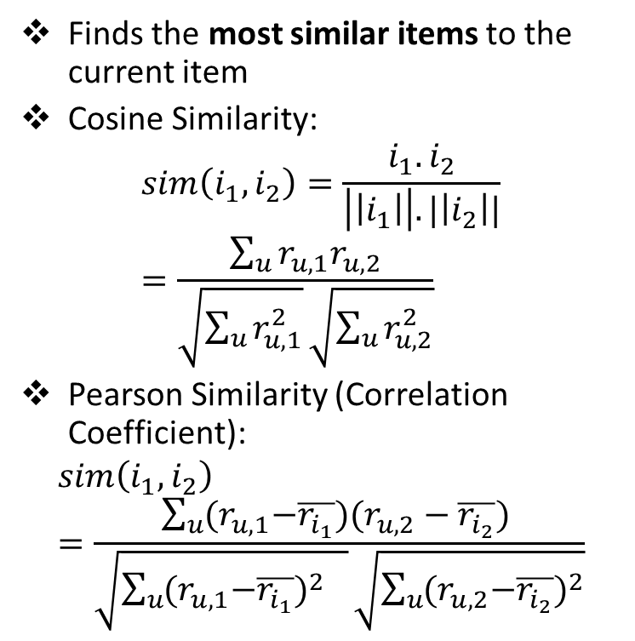
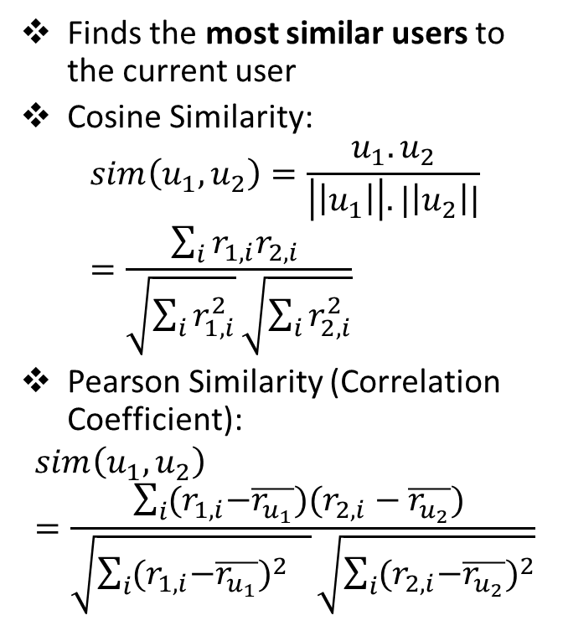
User-based vs. Item-based CF
Finds the most similar users to the current user
Cosine Similarity:
Pearson Similarity (Correlation Coefficient):
Finds the most similar items to the current item
Cosine Similarity:
Pearson Similarity (Correlation Coefficient):

Slide 46
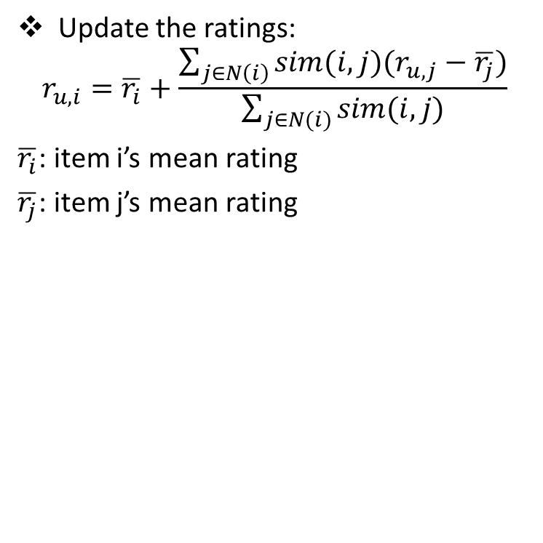
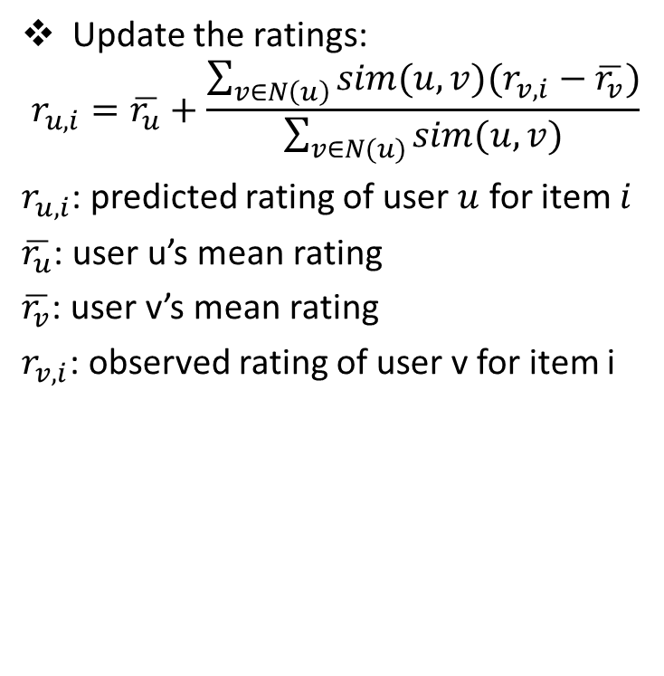
User-based vs. Item-based CF
Update the ratings:
$$r_{u,i}=\overline{r_{u}}+\frac{\sum_{v∈N\left(u\right)}{sim(u,v)(r_{v,i}−\overline{r_{v}})}}{\sum_{v∈N(u)}{sim(u,v)}}$$
$r_{u,i}$: predicted rating of user $u$ for item $i$
$\overline{r_{u}}$: user u’s mean rating
$\overline{r_{v}}$: user v’s mean rating
$r_{v,i}$: observed rating of user v for item i
Update the ratings:
$$r_{u,i}=\overline{r_{i}}+\frac{\sum_{j∈N\left(i\right)}{sim(i,j)(r_{u,j}−\overline{r_{j}})}}{\sum_{j∈N(i)}{sim(i,j)}}$$
$\overline{r_{i}}$: item i’s mean rating
$\overline{r_{j}}$: item j’s mean rating

Slide 47
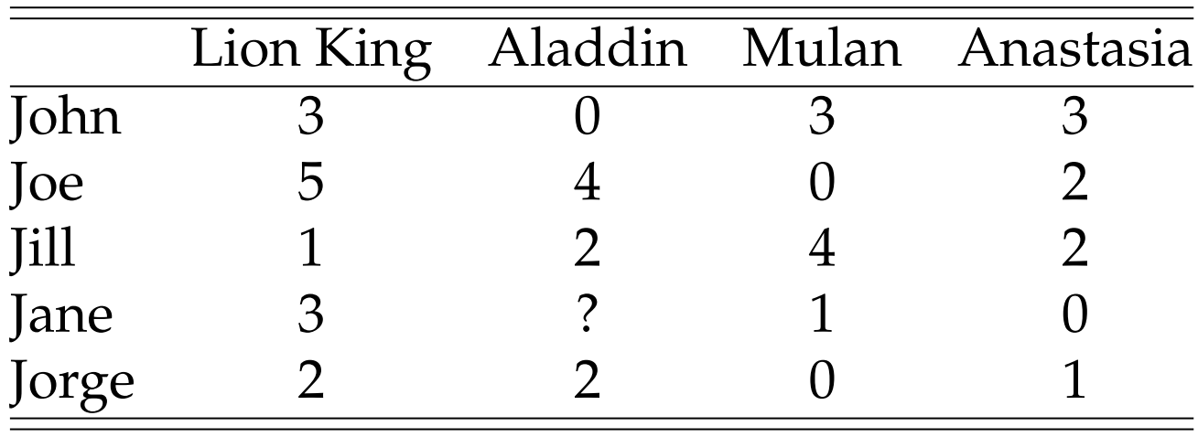
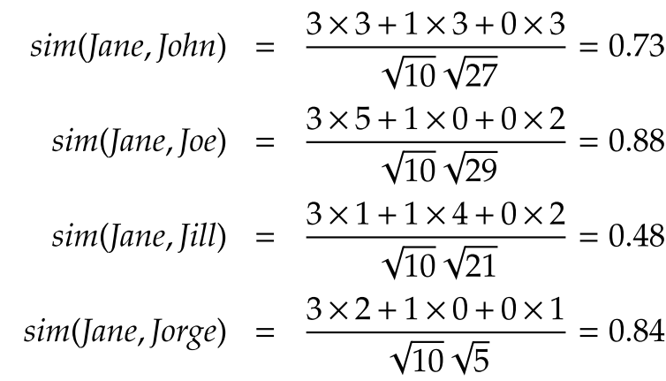
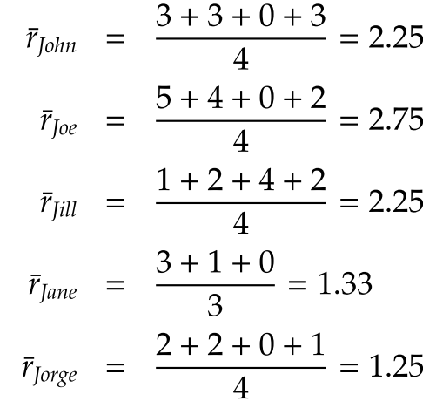
User-based CF, Example
Predict Jane’s rating for Aladdin
1- Calculate average ratings
2- Calculate user-user similarity
Notes:
Predict Jane’s rating for Aladdin

Slide 48
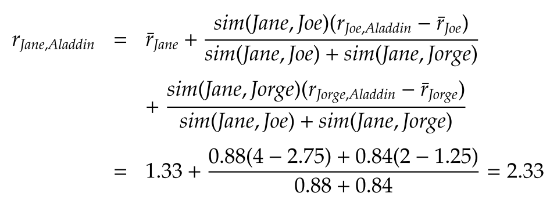
User-based CF, Example (cont’d)
3- Calculate Jane’s rating for Aladdin, Assume that neighborhood size = 2

Slide 49
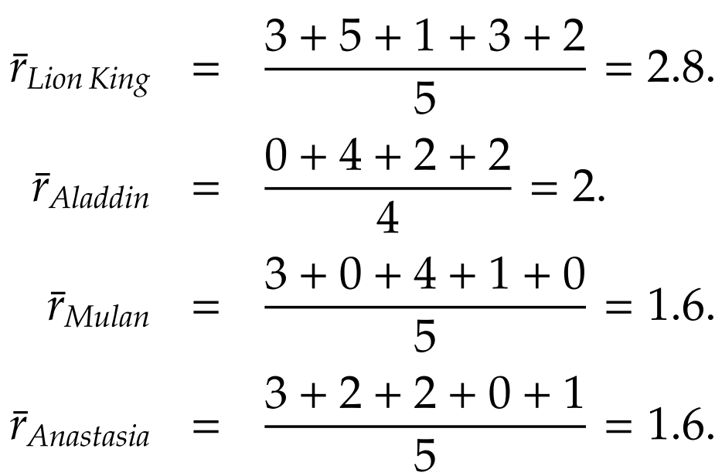
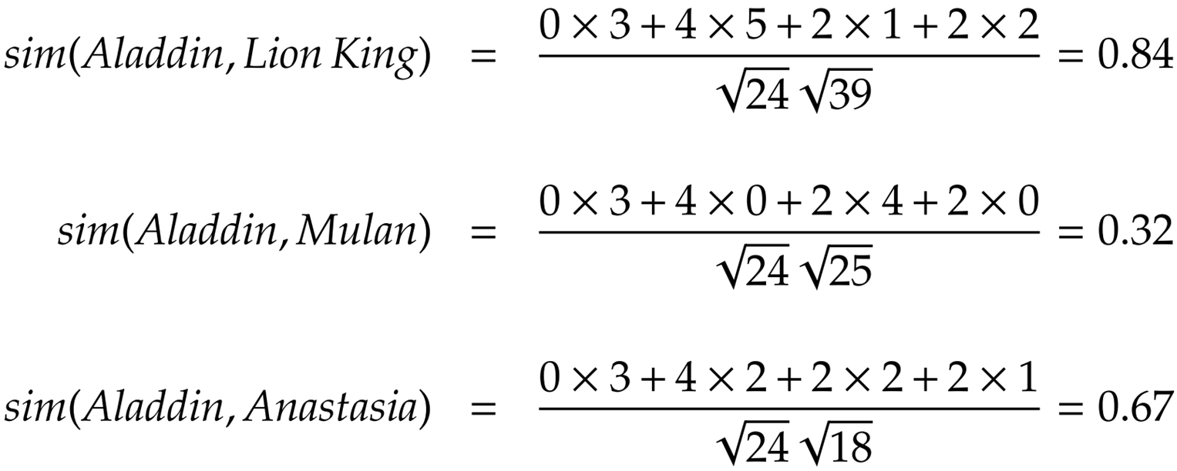
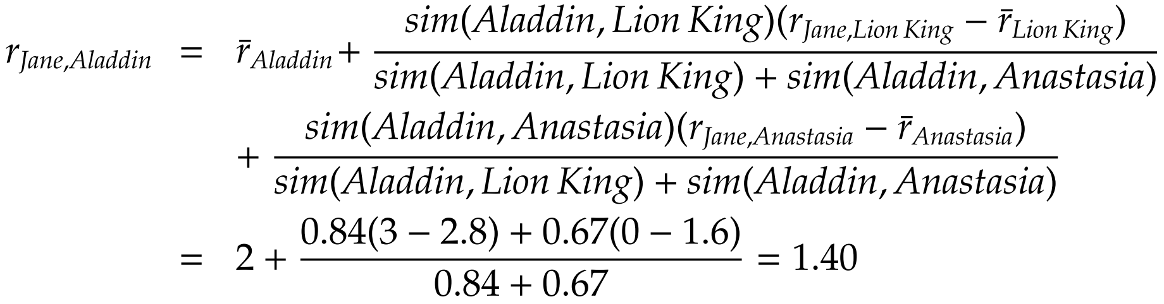
Item-based CF, Example
1- Calculate average ratings
2- Calculate item-item similarity
3- Calculate Jane’s rating for Aladdin, Assume that neighborhood size = 2

Slide 50
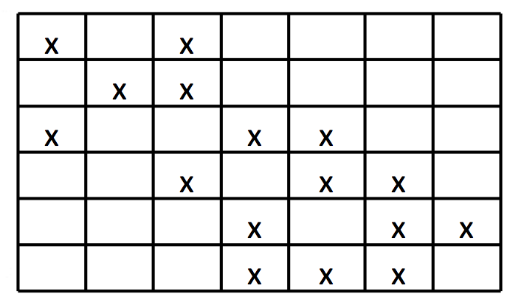
3. Clustering-based Recommendation
Limitations of rating-based recommendation:
Hard to scale with large data
Bad with sparse rating matrix
Bad with diversity of users and items
Items
Users

Slide 51
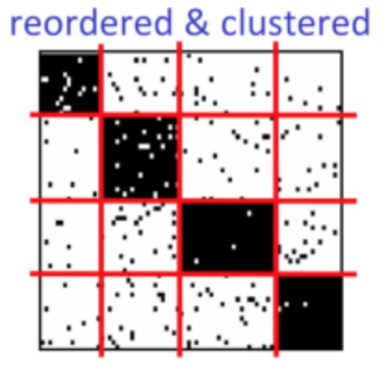
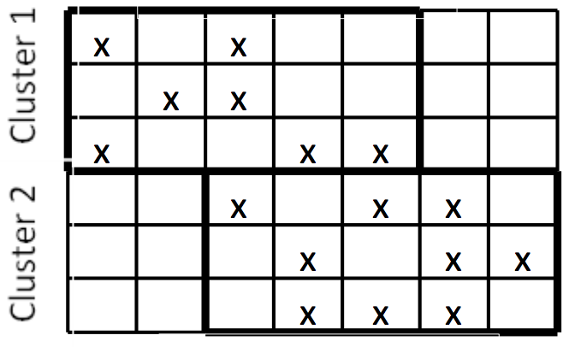
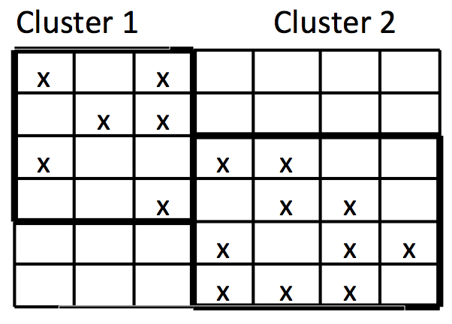
Clustering-based Recommendation
Solution: clustering the data before-hand
Clustering based on ratings: k-means [*], etc.
One-dimension clustering: user clustering, item clustering
Co-clustering
Then, perform rating-based recommendation on each cluster
Items
Users
User clustering
Item clustering
Co-clustering
[*] Al Mamunur Rashid, Shyong K. Lam, George Karypis, and John Riedl. "ClustKNN: a highly scalable hybrid model-& memory-based CF algorithm." Proceeding of WebKDD 2006 (2006).

Slide 52
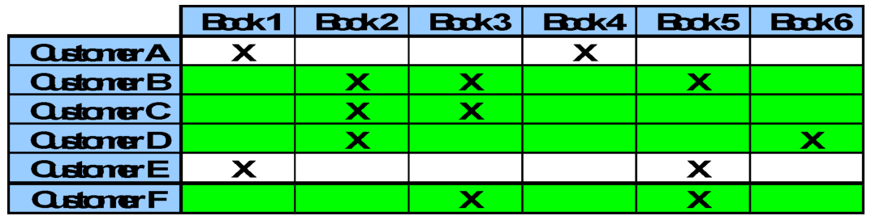
Clustering-based Recommendation – How does it work?
Any customer that shall be classified as a member of CLUSTER will received recommendations based on preferences of the group:
Book 2 will be highly recommended to Customer F
Book 6 will also be recommended to some extent
Pros:
Overcome the sparse data problem
Capture latent similarities between users and items
Cons:
Recommendations (per cluster) maybe less relevant than collaborative filtering (per individual)

Slide 53
RecSys - Performance Measures
Qualitative measures:
User Satisfaction (e.g. questionnaire)
Quantitative measures:
If ground truth is not available:
Add-on sales
Click-through rates
Number of products purchased
If ground truth is available:
Predictive accuracy:
The ratio of predicted ratings being the true user ratings?
Rank accuracy

Slide 54
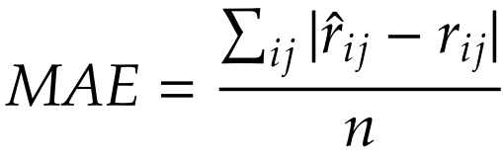
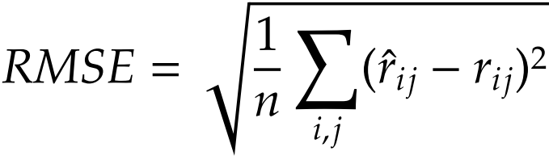
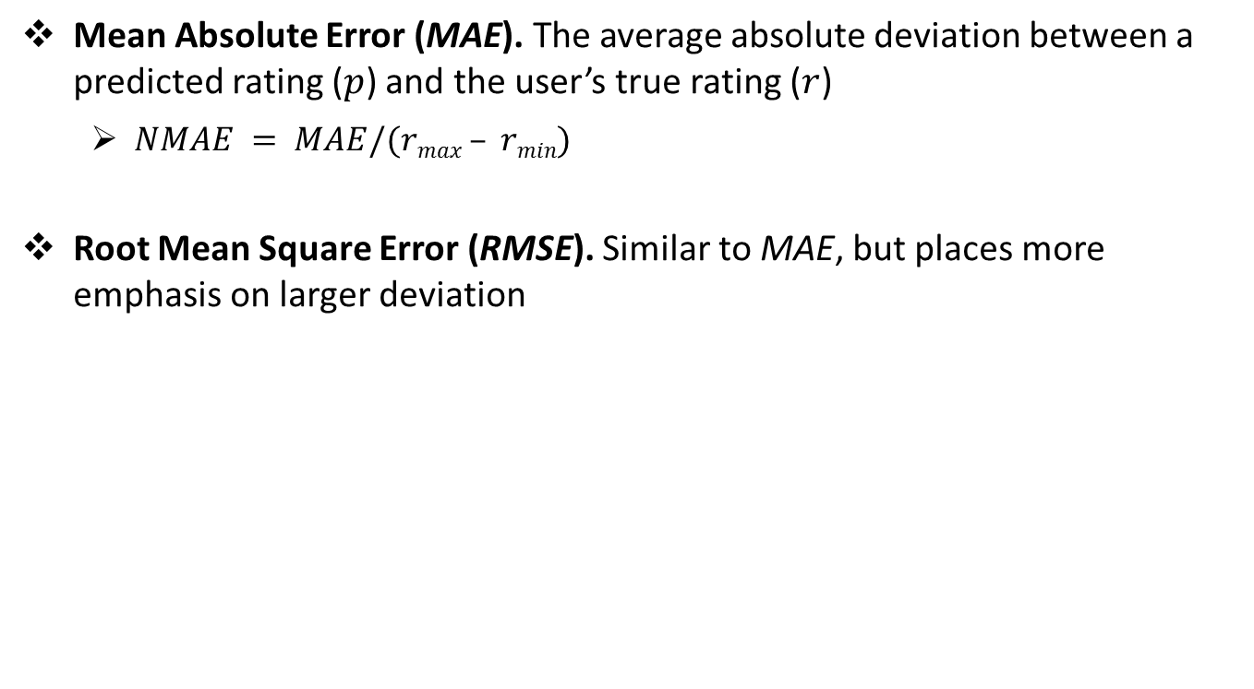
Predictive accuracy
Mean Absolute Error (MAE). The average absolute deviation between a predicted rating ($p$) and the user’s true rating ($r$)
$NMAE = MAE/(rmax – rmin)$
Root Mean Square Error (RMSE). Similar to MAE, but places more emphasis on larger deviation

Slide 55
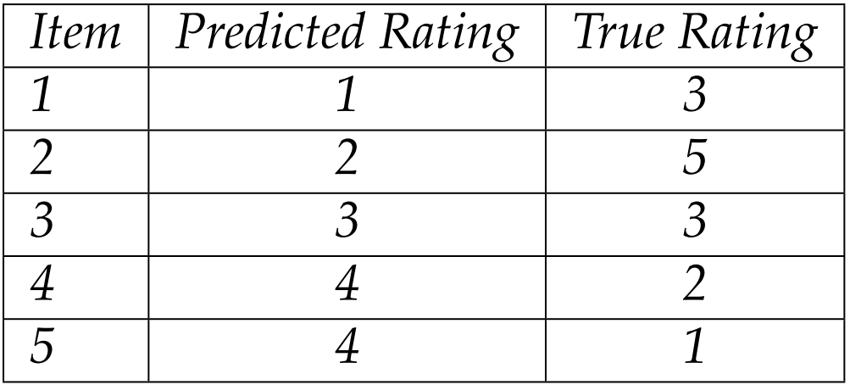
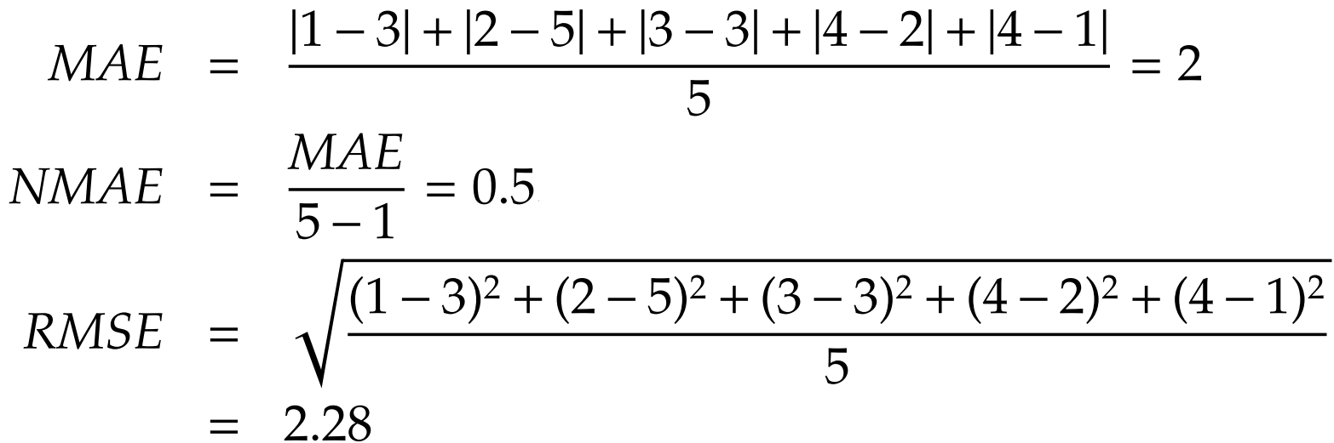
Evaluation Example

Slide 56
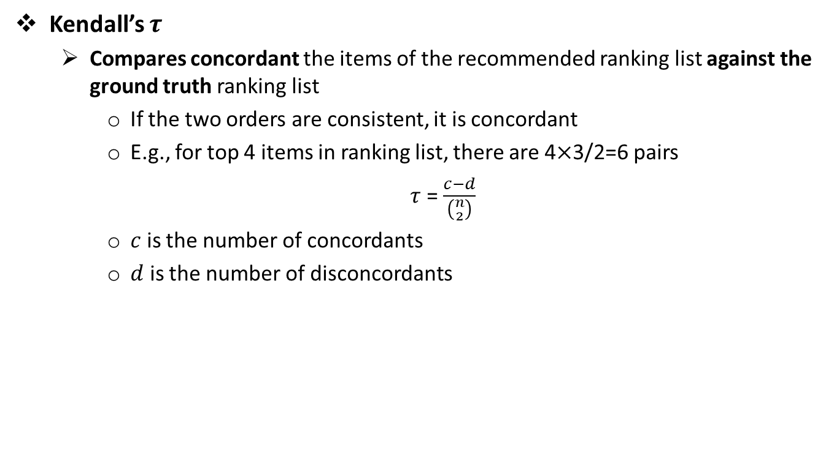
Rank Accuracy
Kendall’s $τ$
Compares concordant the items of the recommended ranking list against the ground truth ranking list
If the two orders are consistent, it is concordant
E.g., for top 4 items in ranking list, there are 4$×$3/2=6 pairs
$τ$ = $\frac{c−d}{\left({n \atop 2}\right)}$
$c$ is the number of concordants
$d$ is the number of disconcordants

Slide 57
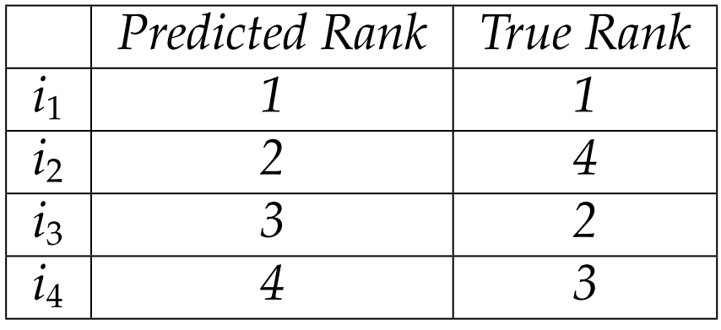
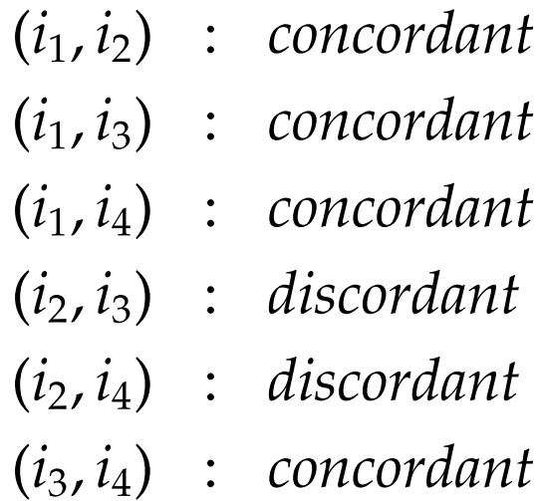
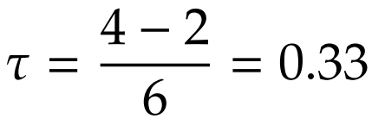
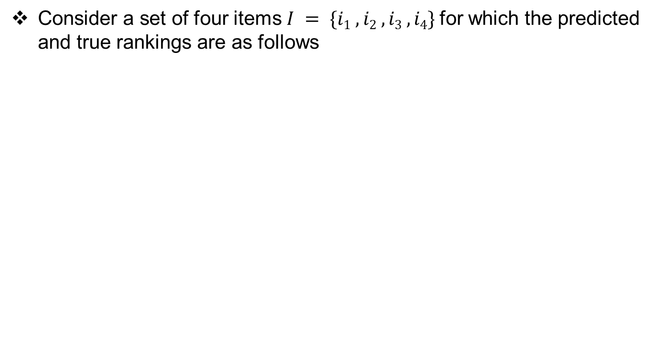
Ranking Accuracy: Example
Consider a set of four items $I = \{i1 , i2 , i3 , i4\}$for which the predicted and true rankings are as follows
Pair of items and their status {concordant/discordant} are

Slide 58
References
[1] https://blog.exploratory.io/find-correlation-or-similarity-among-categories-or-variables-4813130f53c0
[2] https://blog.exploratory.io/an-introduction-to-regression-analysis-in-exploratory-9422237c0ff8
[3] https://www.slideshare.net/PhamCuong/clustering-technique-for-collaborative-filtering-recommendation-and-application-to-venue-recommendation
[4] R. Zafarani, M. A. Abbasi, and H. Liu, Social Media Mining: An Introduction, Cambridge University Press, 2014. http://socialmediamining.info/
[5] https://www.slideshare.net/xamat/recommender-systems-machine-learning-summer-school-2014-cmu
[6] Business Forecasting: Pearson New International Edition, 9/E Hanke & Wichern ©2014 | Pearson | Published: 15 Aug 2013 ISBN-10: 1292023007 | ISBN-13: 9781292023007
[7] http://business.unr.edu/faculty/ronlembke/handouts/Seasonality%20Final17.pdf

